Slide 1
Optimization and Stability in Neural Networks
Advanced Reading in Deep-Learning and Vision, Spring 2017
Dror Kaufmann, Nitzan Artzi

Slide 2
Outline
Stability of a learning algorithm, implications¹
Stability of the Stochastic Gradient Descent¹
Variants of SGD¹
Failures of gradient-based methods²
Bonus: some notes on architecture³
Train faster, generalize better: Stability of stochastic gradient descent. Hardt, Recht and Singer, 2016
Failures of Deep Learning. Shalev-Shwartz, Shamir and Shammah, 2017
On the Sample Complexity of End-to-end Training vs. Semantic Abstraction Training. Shalev-Schartz and Shashua, 2016

Slide 3
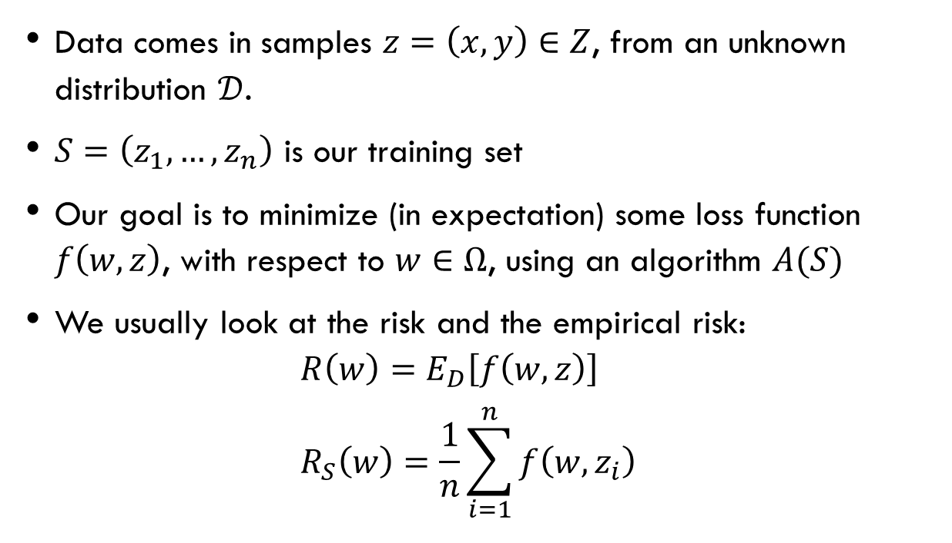
The classic approach to statistical learning
Data comes in samples $z=\left(x,y\right)∈Z$, from an unknown distribution $𝒟$.
$S=\left(z_{1},…,z_{n}\right)$ is our training set
Our goal is to minimize (in expectation) some loss function $f\left(w,z\right)$, with respect to $w∈Ω$, using an algorithm $A(S)$
We usually look at the risk and the empirical risk: $R\left(w\right)=E_{D}\left[f\left(w,z\right)\right]$ $R_{S}\left(w\right)=\frac{1}{n}\sum_{i=1}^{n}{f\left(w,z_{i}\right)}$

Slide 4

Generalization and overfitting
$$ε_{gen}=E_{S,A}\left[R\left(A\left(S\right)\right)−R_{S}\left(A\left(S\right)\right)\right]$$

Slide 5
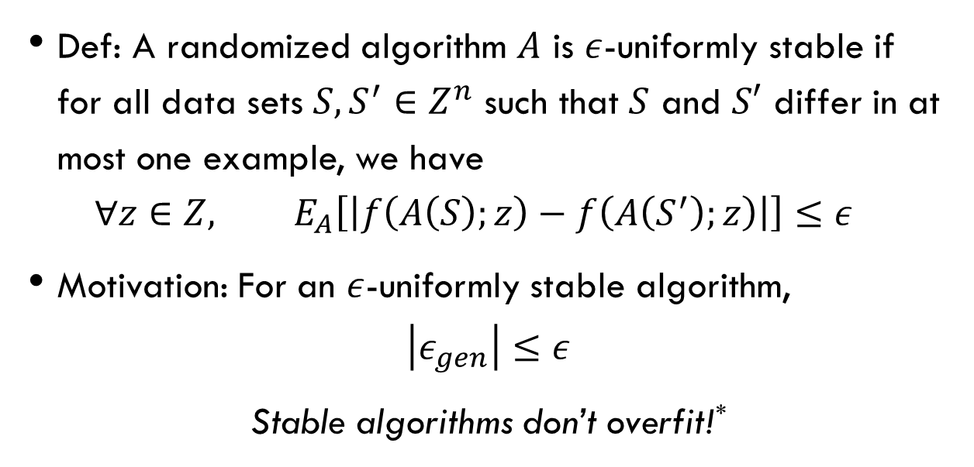
stability
Def: A randomized algorithm $A$ is $ε$-uniformly stable if for all data sets $S, S^{′}∈Z^{n}$ such that $S$ and $S′$ differ in at most one example, we have $∀z∈Z, E_{A}\left[\left|f\left(A\left(S\right);z\right)−f\left(A\left(S^{′}\right);z\right)\right|\right]≤ε$
Motivation: For an $ε$-uniformly stable algorithm, $\left|ε_{gen}\right|≤ε$
Stable algorithms don’t overfit!*

Slide 6
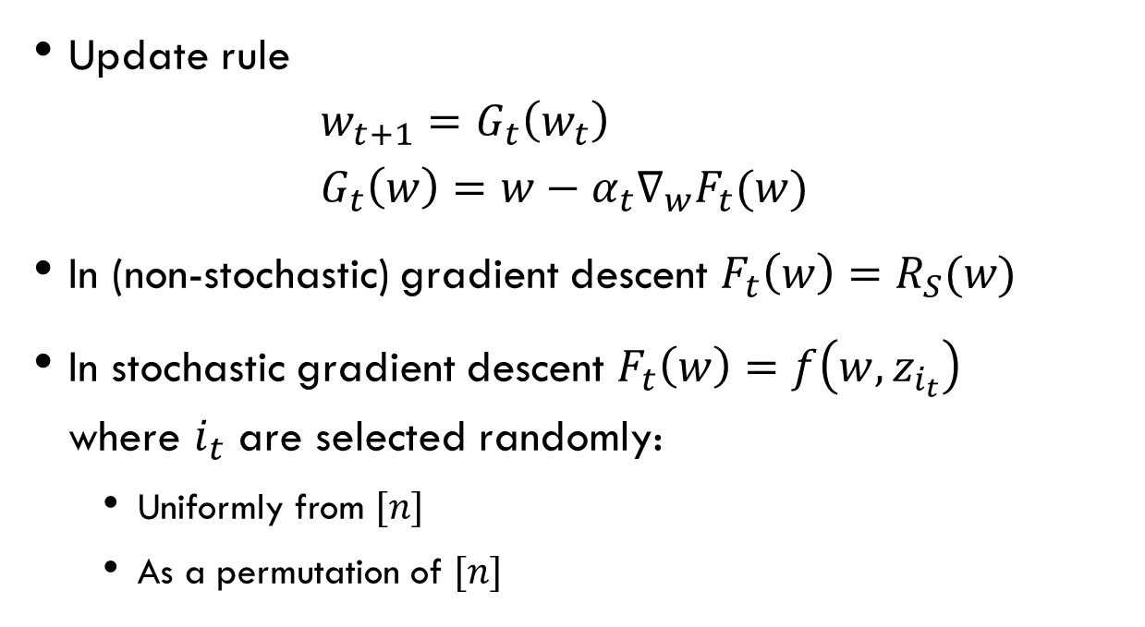
Gradient descent
Update rule $w_{t+1}=G_{t}\left(w_{t}\right)$ $G_{t}\left(w\right)=w−α_{t}∇_{w}F_{t}(w)$
In (non-stochastic) gradient descent $F_{t}\left(w\right)=R_{S}(w)$
In stochastic gradient descent $F_{t}\left(w\right)=f\left(w,z_{i_{t}}\right)$ where $i_{t}$ are selected randomly:
Uniformly from $[n]$
As a permutation of $[n]$

Slide 7
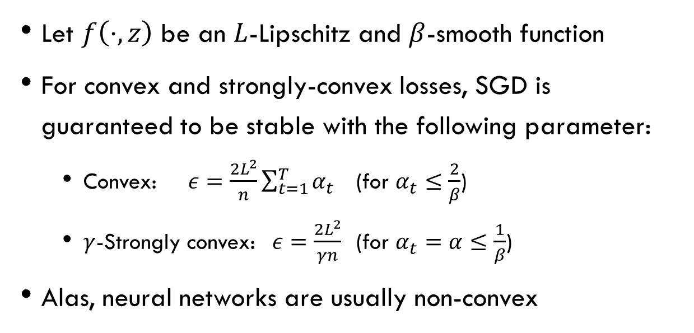
Stability of SGD
Let $f\left(⋅,z\right)$ be an $L$-Lipschitz and $β$-smooth function
For convex and strongly-convex losses, SGD is guaranteed to be stable with the following parameter:
Convex: $ε=\frac{2L^{2}}{n}\sum_{t=1}^{T}{α_{t}}$ (for $α_{t}≤\frac{2}{β}$)
$γ$-Strongly convex: $ε=\frac{2L^{2}}{γn}$ (for $α_{t}=α≤\frac{1}{β}$)
Alas, neural networks are usually non-convex

Slide 8




Non-convexity of NN
$$α$$
$$1$$
$$β$$
$$1$$

Slide 9
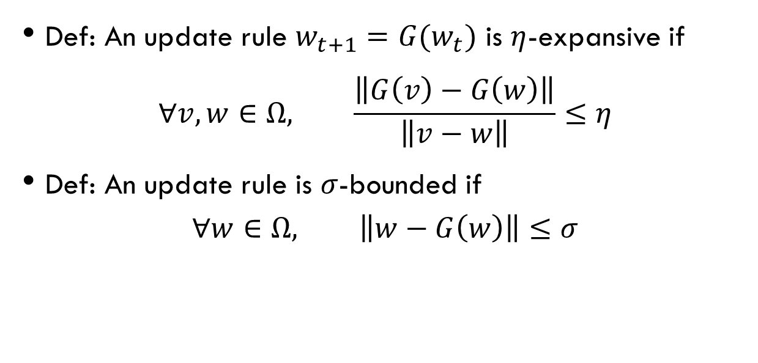
Properties of update rules
Def: An update rule $w_{t+1}=G(w_{t})$ is $η$-expansive if $∀v,w∈Ω, \frac{\left\|G\left(v\right)−G\left(w\right)\right\|}{\left\|v−w\right\|}≤η$
Def: An update rule is $σ$-bounded if $∀w∈Ω, \left\|w−G\left(w\right)\right\|≤σ$

Slide 10
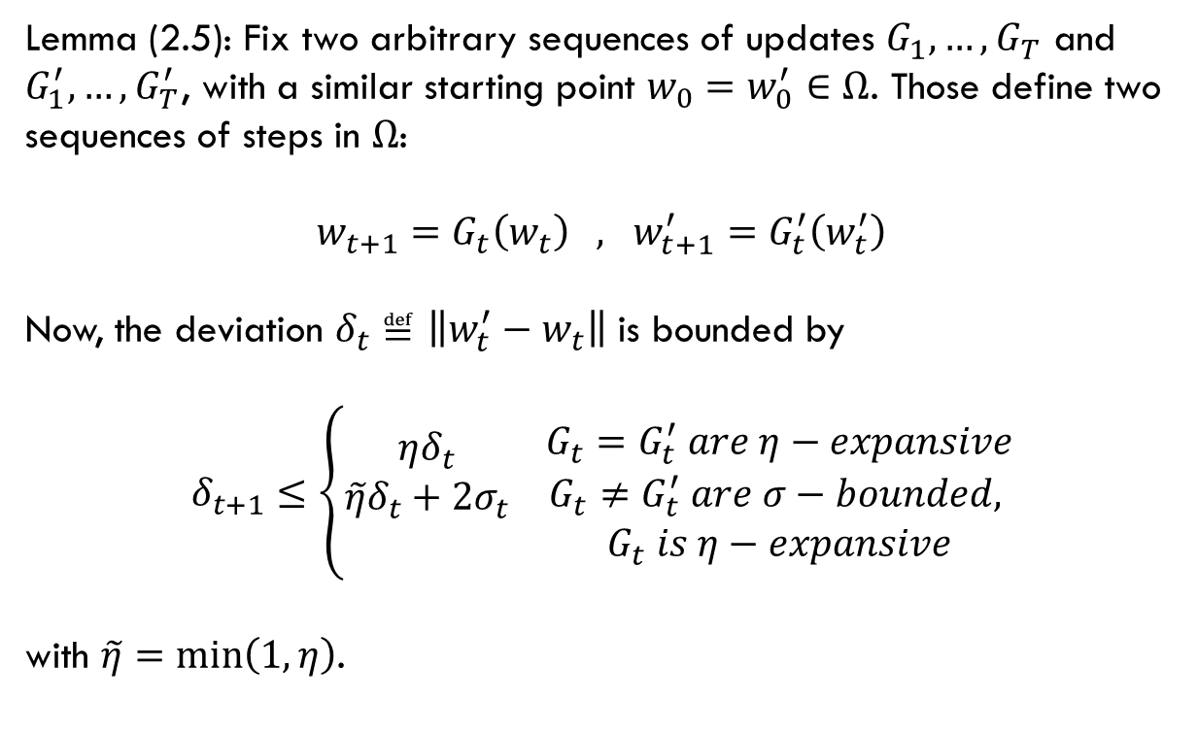
Growth recursion
Lemma (2.5): Fix two arbitrary sequences of updates $G_{1},…,G_{T}$ and $G_{1}^{′},…,G_{T}^{′}$, with a similar starting point $w_{0}=w_{0}^{′}∈Ω$. Those define two sequences of steps in $Ω$: $w_{t+1}=G_{t}\left(w_{t}\right) , w_{t+1}^{′}=G_{t}^{′}\left(w_{t}^{′}\right)$ Now, the deviation $δ_{t}≝\left\|w_{t}^{′}−w_{t}\right\|$ is bounded by $$δ_{t+1}≤\left\{\begin{aligned}ηδ_{t} \\ \tilde{η}δ_{t}+2σ_{t} \\ \end{aligned} \begin{matrix}G_{t}=G_{t}^{′} are η−expansive \\ \begin{aligned}G_{t}≠G_{t}^{′} are σ−bounded, \\ G_{t} is η−expansive\end{aligned}\end{matrix}\right.$$ with $\tilde{η}=\min\left(1,η\right)$.

Slide 11
SGD is stable – outline
Main ideas in the stability proof:
In SGD we use only one example in each iteration, so at the beginning we are unlikely so select the different example
Using the growth recursion lemma, we can find a bound on the on the deviance between the outputs of the algorithms

Slide 12
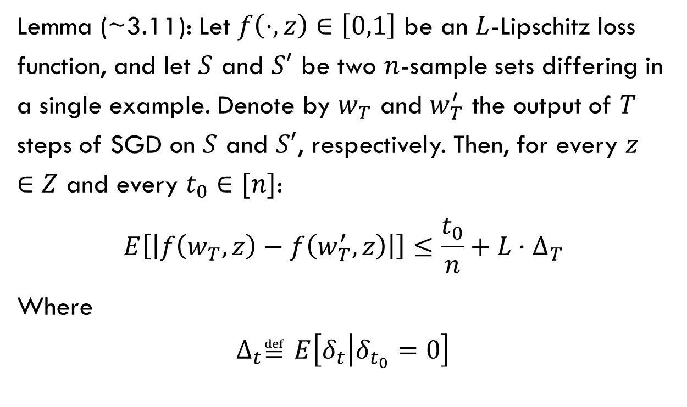
SGD is stable – Lemma
Lemma (~3.11): Let $f\left(⋅,z\right)∈\left[0,1\right]$ be an $L$-Lipschitz loss function, and let $S$ and $S′$ be two $n$-sample sets differing in a single example. Denote by $w_{T}$ and $w_{T}^{′}$ the output of $T$ steps of SGD on $S$ and $S′$, respectively. Then, for every $z∈Z$ and every $t_{0}∈[n]$:
$$E\left[\left|f\left(w_{T},z\right)−f\left(w_{T}^{′},z\right)\right|\right]≤\frac{t_{0}}{n}+L⋅∆_{T}$$
Where
$$∆_{t}≝E\left[δ_{t} | δ_{t_{0}}=0\right]$$

Slide 13
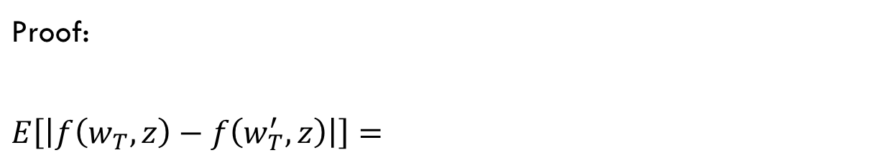
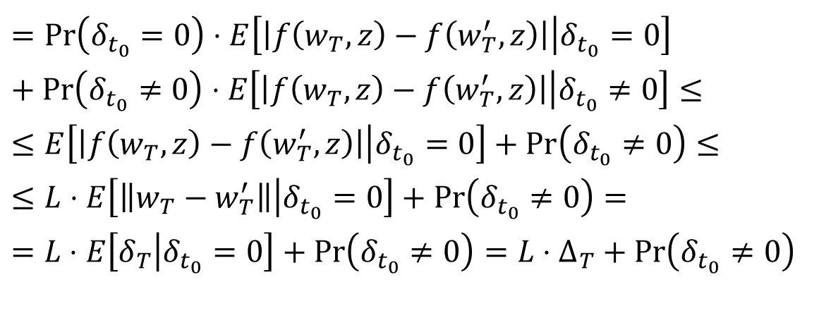
SGD is stable – Lemma
$$\text{Proof}\text{:}$$
$$E\left[\left|f\left(w_{T},z\right)−f\left(w_{T}^{′},z\right)\right|\right]=$$
$$=\operatorname{Pr}\left(δ_{t_{0}}=0\right)⋅E\left[\left|f\left(w_{T},z\right)−f\left(w_{T}^{′},z\right)\right| | δ_{t_{0}}=0\right]+\operatorname{Pr}\left(δ_{t_{0}}≠0\right)⋅E\left[\left|f\left(w_{T},z\right)−f\left(w_{T}^{′},z\right)\right| | δ_{t_{0}}≠0\right]≤$$
$$≤E\left[\left|f\left(w_{T},z\right)−f\left(w_{T}^{′},z\right)\right| | δ_{t_{0}}=0\right]+\operatorname{Pr}\left(δ_{t_{0}}≠0\right)≤$$
$$≤L⋅E\left[\left\|w_{T}−w_{T}^{′}\right\| | δ_{t_{0}}=0\right]+\operatorname{Pr}\left(δ_{t_{0}}≠0\right)=$$
$$=L⋅E\left[δ_{T} | δ_{t_{0}}=0\right]+\operatorname{Pr}\left(δ_{t_{0}}≠0\right)=L⋅∆_{T}+\operatorname{Pr}\left(δ_{t_{0}}≠0\right)$$

Slide 14
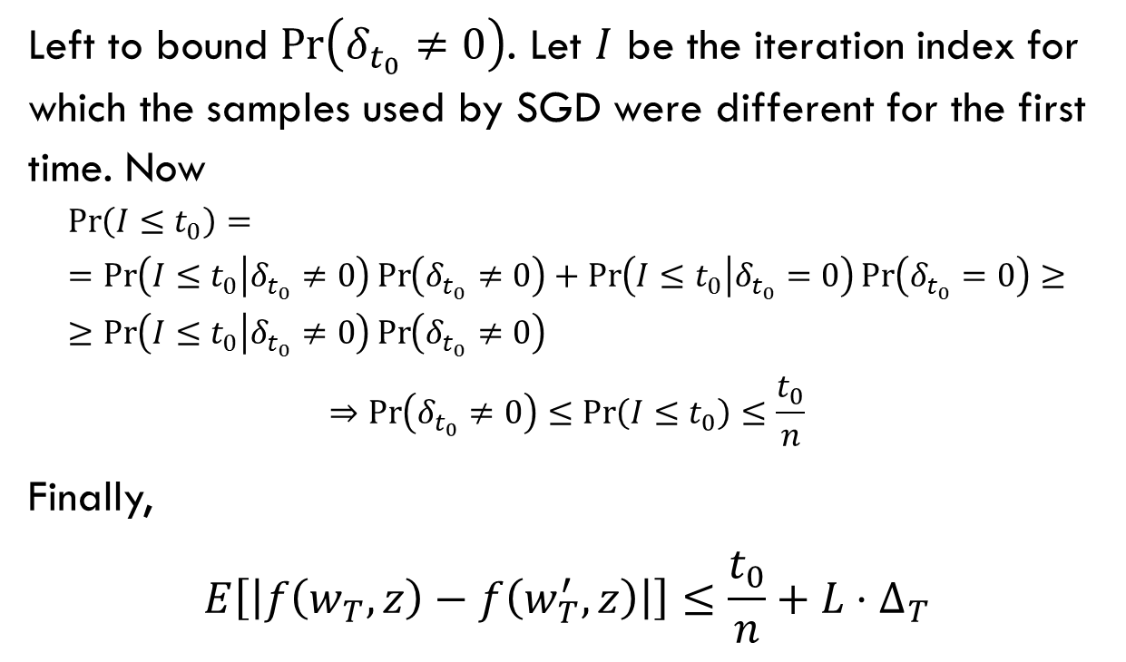
SGD is stable – Lemma
Left to bound $\operatorname{Pr}\left(δ_{t_{0}}≠0\right)$. Let $I$ be the iteration index for which the samples used by SGD were different for the first time. Now
$$\operatorname{Pr}\left(I≤t_{0}\right)==\operatorname{Pr}\left(I≤t_{0} | δ_{t_{0}}≠0\right)\operatorname{Pr}\left(δ_{t_{0}}≠0\right)+\operatorname{Pr}\left(I≤t_{0} | δ_{t_{0}}=0\right)\operatorname{Pr}\left(δ_{t_{0}}=0\right)≥≥\operatorname{Pr}\left(I≤t_{0} | δ_{t_{0}}≠0\right)\operatorname{Pr}\left(δ_{t_{0}}≠0\right)$$
$$⇒\operatorname{Pr}\left(δ_{t_{0}}≠0\right)≤\operatorname{Pr}\left(I≤t_{0}\right)≤\frac{t_{0}}{n}$$
Finally,
$$E\left[\left|f\left(w_{T},z\right)−f\left(w_{T}^{′},z\right)\right|\right]≤\frac{t_{0}}{n}+L⋅∆_{T}$$

Slide 15
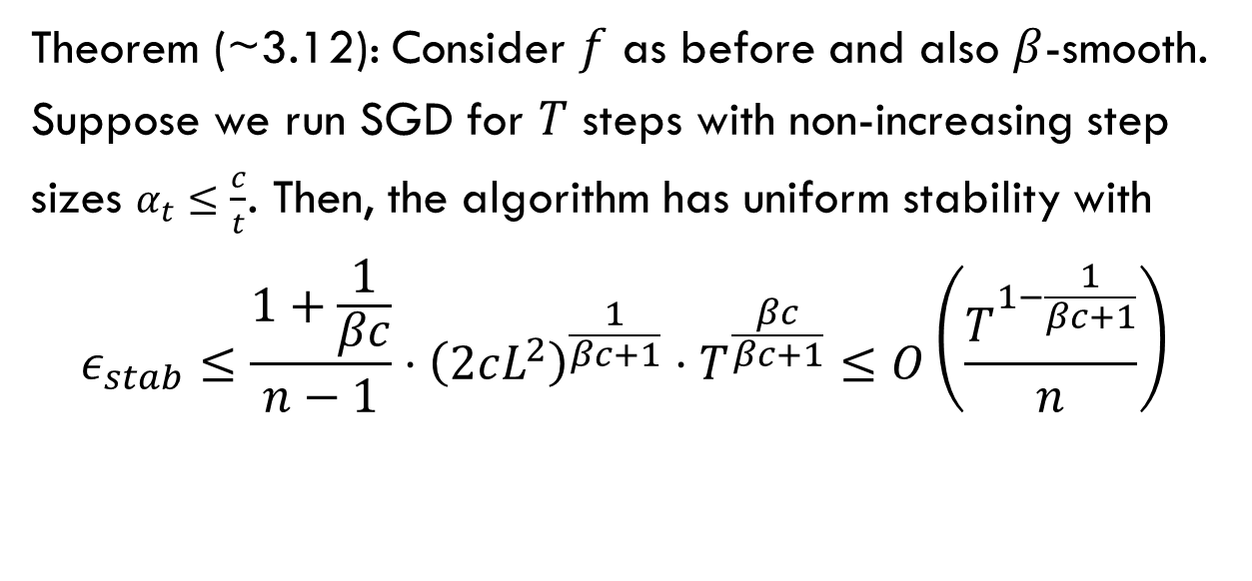
SGD is stable – Main theorem
Theorem (~3.12): Consider $f$ as before and also $β$-smooth. Suppose we run SGD for $T$ steps with non-increasing step sizes $α_{t}≤\frac{c}{t}$. Then, the algorithm has uniform stability with
$$ε_{stab}≤\frac{1+\frac{1}{βc}}{n−1}⋅{\left(2cL^{2}\right)}^{\frac{1}{βc+1}}⋅T^{\frac{βc}{βc+1}}≤O\left(\frac{T^{1−\frac{1}{βc+1}}}{n}\right)$$

Slide 16
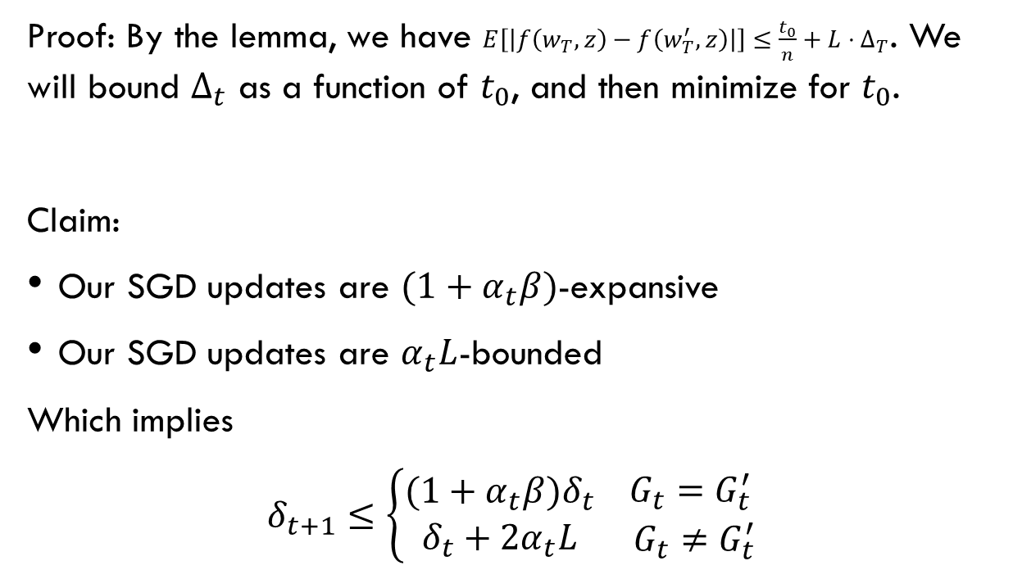
SGD is stable – Main theorem
Proof: By the lemma, we have $E\left[\left|f\left(w_{T},z\right)−f\left(w_{T}^{′},z\right)\right|\right]≤\frac{t_{0}}{n}+L⋅∆_{T}$. We will bound $∆_{t}$ as a function of $t_{0}$, and then minimize for $t_{0}$.
Claim:
Our SGD updates are $(1+α_{t}β)$-expansive
Our SGD updates are $α_{t}L$-bounded
Which implies
$$δ_{t+1}≤\left\{\begin{matrix}(1+α_{t}β)δ_{t} \\ δ_{t}+2α_{t}L\end{matrix} \begin{matrix}G_{t}=G_{t}^{′} \\ G_{t}≠G_{t}^{′}\end{matrix}\right.$$

Slide 17
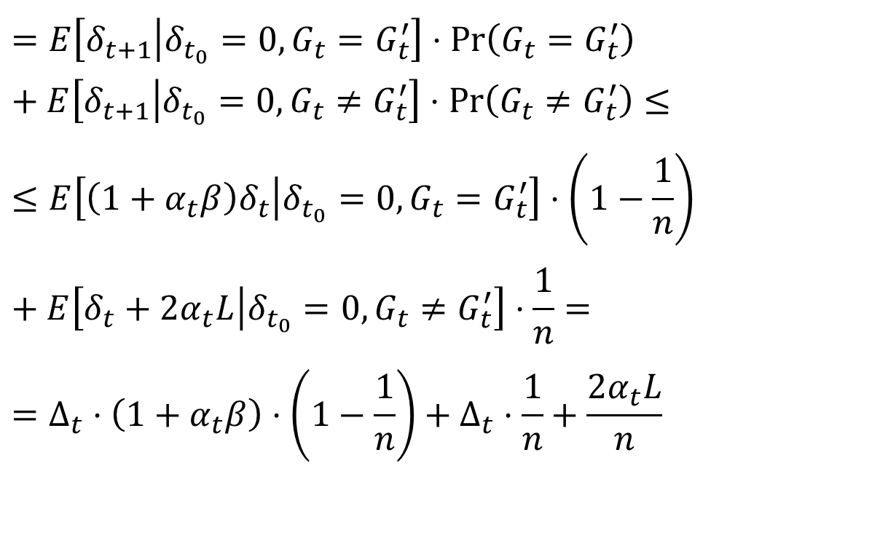
Hence
$$∆_{t+1}=E\left[δ_{t+1} | δ_{t_{0}}=0\right]=$$
$$=E\left[δ_{t+1} | δ_{t_{0}}=0, G_{t}=G_{t}^{′}\right]⋅\operatorname{Pr}\left(G_{t}=G_{t}^{′}\right)+E\left[δ_{t+1} | δ_{t_{0}}=0, G_{t}≠G_{t}^{′}\right]⋅\operatorname{Pr}\left(G_{t}≠G_{t}^{′}\right)≤$$
$$≤E\left[\left(1+α_{t}β\right)δ_{t} | δ_{t_{0}}=0, G_{t}=G_{t}^{′}\right]⋅\left(1−\frac{1}{n}\right)+E\left[δ_{t}+2α_{t}L | δ_{t_{0}}=0, G_{t}≠G_{t}^{′}\right]⋅\frac{1}{n}=$$
$$=∆_{t}⋅\left(1+α_{t}β\right)⋅\left(1−\frac{1}{n}\right)+∆_{t}⋅\frac{1}{n}+\frac{2α_{t}L}{n}$$

Slide 18
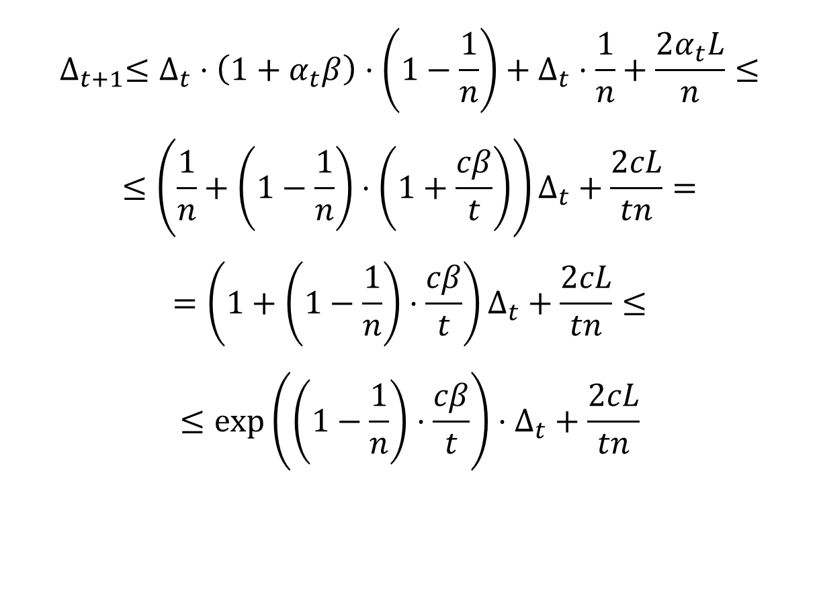
$$∆_{t+1}≤∆_{t}⋅\left(1+α_{t}β\right)⋅\left(1−\frac{1}{n}\right)+∆_{t}⋅\frac{1}{n}+\frac{2α_{t}L}{n}≤$$
$$≤\left(\frac{1}{n}+\left(1−\frac{1}{n}\right)⋅\left(1+\frac{cβ}{t}\right)\right)∆_{t}+\frac{2cL}{tn}=$$
$$=\left(1+\left(1−\frac{1}{n}\right)⋅\frac{cβ}{t}\right)∆_{t}+\frac{2cL}{tn}≤$$
$$≤\exp\left(\left(1−\frac{1}{n}\right)⋅\frac{cβ}{t}\right)⋅∆_{t}+\frac{2cL}{tn}$$

Slide 19
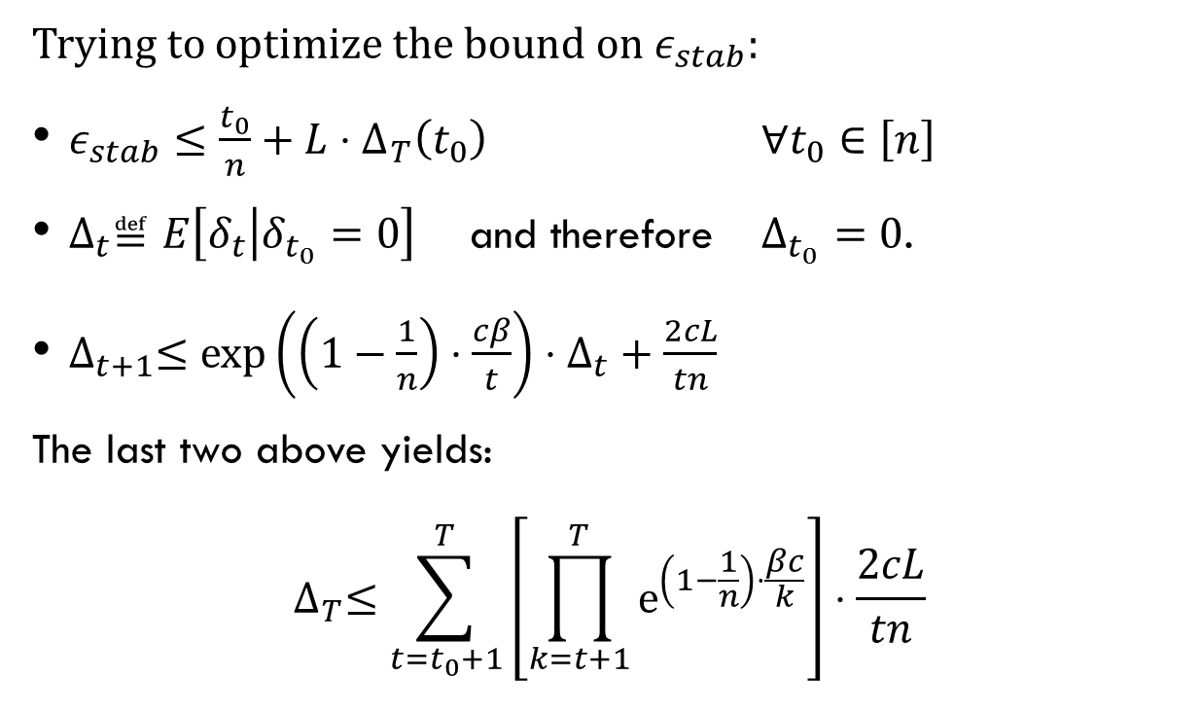
recap
Trying to optimize the bound on $ε_{stab}$:
$ε_{stab}≤\frac{t_{0}}{n}+L⋅∆_{T}\left(t_{0}\right)$ $∀t_{0}∈\left[n\right]$
$∆_{t}≝E\left[δ_{t} | δ_{t_{0}}=0\right]$ and therefore $Δ_{t_{0}}=0$.
$∆_{t+1}≤\exp\left(\left(1−\frac{1}{n}\right)⋅\frac{cβ}{t}\right)⋅∆_{t}+\frac{2cL}{tn}$
The last two above yields:
$$∆_{T}≤\sum_{t=t_{0}+1}^{T}{\left[\prod_{k=t+1}^{T}{e^{\left(1−\frac{1}{n}\right)⋅\frac{βc}{k}}}\right]⋅\frac{2cL}{tn}}$$

Slide 20
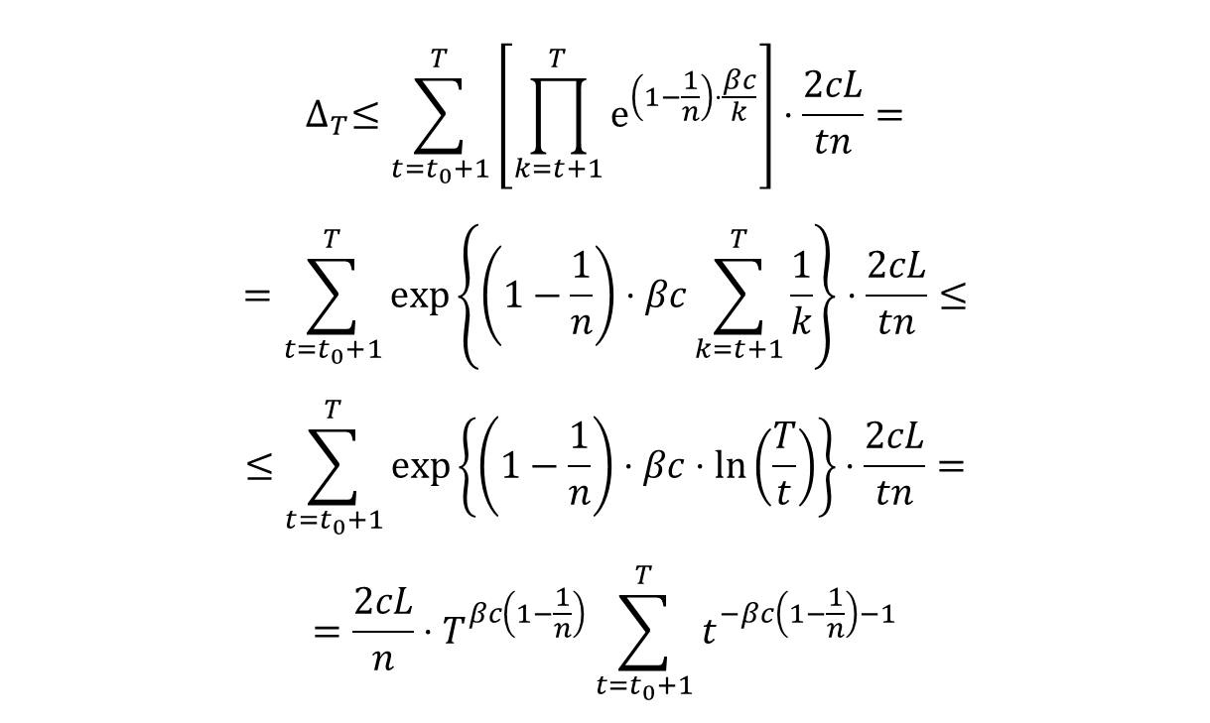
SGD is stable – Main theorem
$$∆_{T}≤\sum_{t=t_{0}+1}^{T}{\left[\prod_{k=t+1}^{T}{e^{\left(1−\frac{1}{n}\right)⋅\frac{βc}{k}}}\right]⋅\frac{2cL}{tn}}=$$
$$=\sum_{t=t_{0}+1}^{T}{\exp\left\{\left(1−\frac{1}{n}\right)⋅βc\sum_{k=t+1}^{T}{\frac{1}{k}}\right\}⋅\frac{2cL}{tn}}≤$$
$$≤\sum_{t=t_{0}+1}^{T}{\exp\left\{\left(1−\frac{1}{n}\right)⋅βc⋅\ln\left(\frac{T}{t}\right)\right\}⋅\frac{2cL}{tn}}=$$
$$=\frac{2cL}{n}⋅T^{βc\left(1−\frac{1}{n}\right)}\sum_{t=t_{0}+1}^{T}{t^{−βc\left(1−\frac{1}{n}\right)−1}}$$

Slide 21

$$∆_{T}≤\frac{2cL}{n}⋅T^{βc\left(1−\frac{1}{n}\right)}\sum_{t=t_{0}+1}^{T}{t^{−βc\left(1−\frac{1}{n}\right)−1}}≤≤\frac{2cL}{n}⋅T^{βc\left(1−\frac{1}{n}\right)}⋅\frac{1}{βc\left(1−\frac{1}{n}\right)}⋅t_{0}^{−βc\left(1−\frac{1}{n}\right)}≤ \\ ≤\frac{2L}{β\left(n−1\right)}⋅{\left(\frac{T}{t_{0}}\right)}^{βc}$$
Which means
$$ε_{stab}≤\frac{t_{0}}{n}+\frac{2L^{2}}{β\left(n−1\right)}⋅{\left(\frac{T}{t_{0}}\right)}^{βc}$$
Setting $t_{0}≈{\left(2cL^{2}\right)}^{\frac{1}{βc+1}}T^{\frac{βc}{βc+1}}$
$$ε_{stab}≤\frac{1+\frac{1}{βc}}{n−1}⋅{\left(2cL^{2}\right)}^{\frac{1}{βc+1}}⋅T^{\frac{βc}{βc+1}}$$

Slide 22
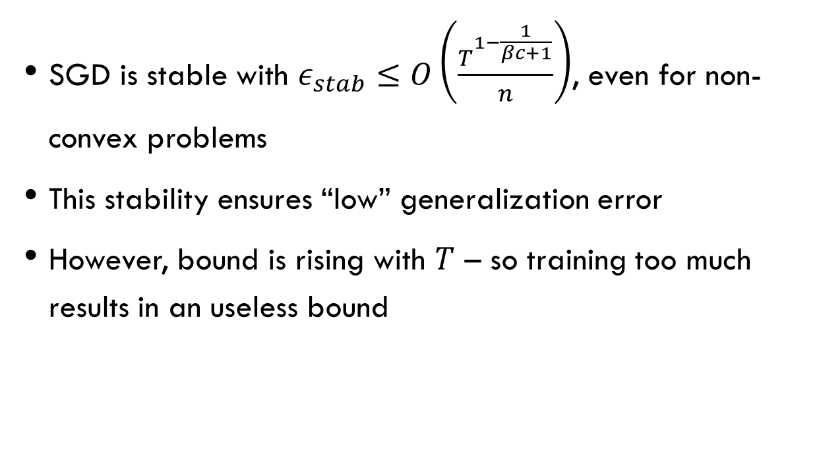
Stability of SGD – conclusion
SGD is stable with $ε_{stab}≤O\left(\frac{T^{1−\frac{1}{βc+1}}}{n}\right)$, even for non-convex problems
This stability ensures “low” generalization error
However, bound is rising with $T$ – so training too much results in an useless bound

Slide 23
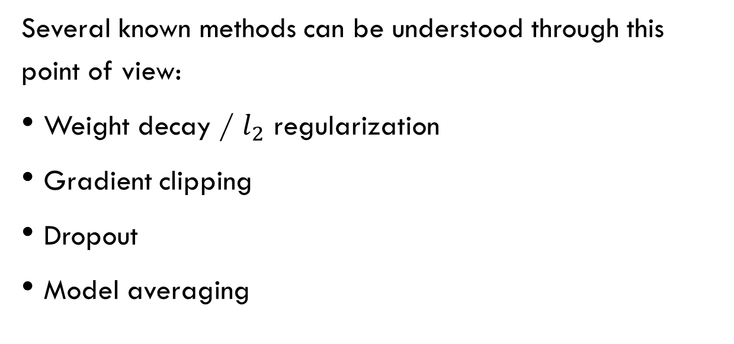
Stability inducing operations
Several known methods can be understood through this point of view:
Weight decay / $l_{2}$ regularization
Gradient clipping
Dropout
Model averaging

Slide 24
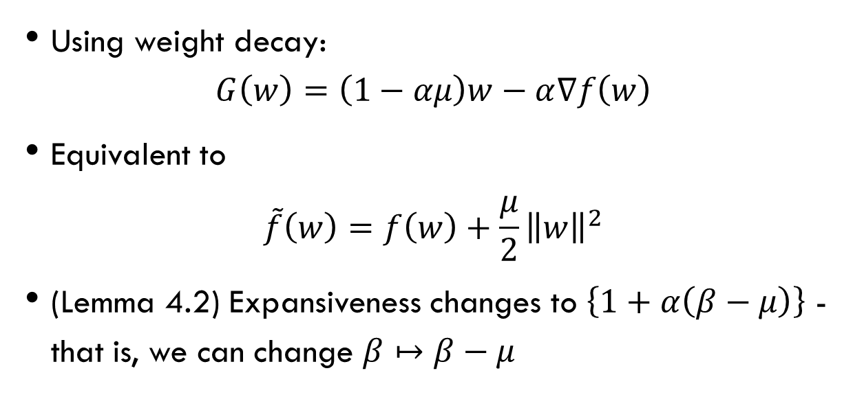
Weight decay
Using weight decay:
$$G\left(w\right)=\left(1−αμ\right)w−α∇f\left(w\right)$$
Equivalent to
$$\tilde{f}\left(w\right)=f\left(w\right)+\frac{μ}{2}{\left\|w\right\|}^{2}$$
(Lemma 4.2) Expansiveness changes to $\left\{1+α\left(β−μ\right)\right\}$ - that is, we can change $β↦β−μ$

Slide 25
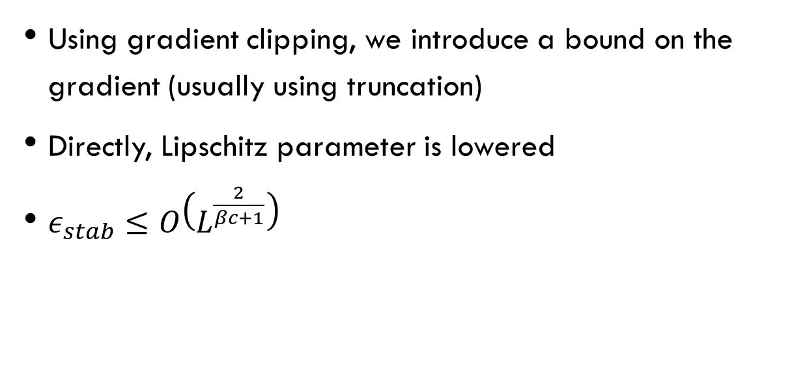
Gradient clipping
Using gradient clipping, we introduce a bound on the gradient (usually using truncation)
Directly, Lipschitz parameter is lowered
$ε_{stab}≤O\left(L^{\frac{2}{βc+1}}\right)$

Slide 26
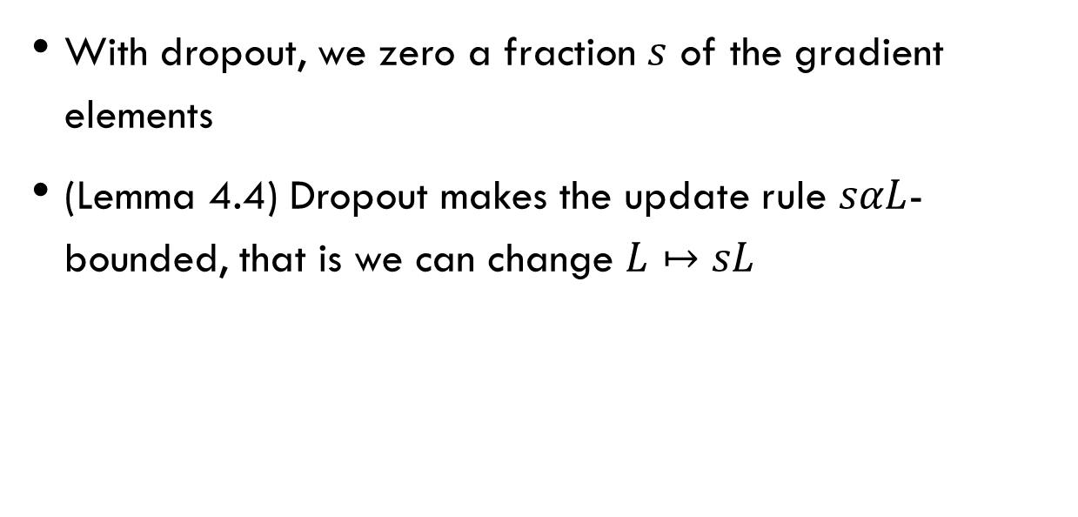
dropout
With dropout, we zero a fraction $s$ of the gradient elements
(Lemma 4.4) Dropout makes the update rule $sαL$-bounded, that is we can change $L↦sL$

Slide 27
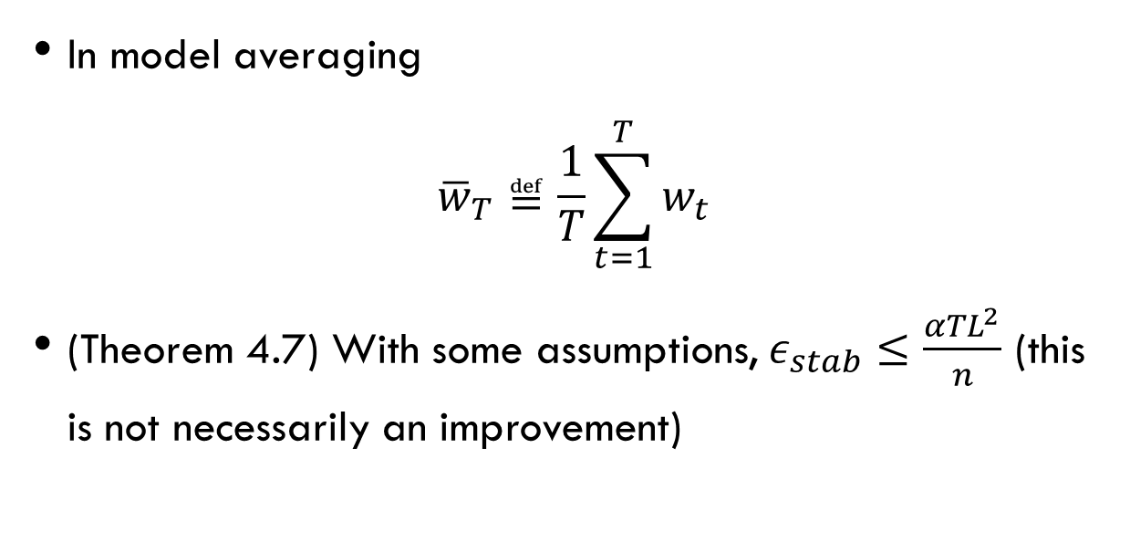
Model averaging
In model averaging
$${\overline{w}}_{T}≝\frac{1}{T}\sum_{t=1}^{T}{w_{t}}$$
(Theorem 4.7) With some assumptions, $ε_{stab}≤\frac{αTL^{2}}{n}$ (this is not necessarily an improvement)

Slide 28
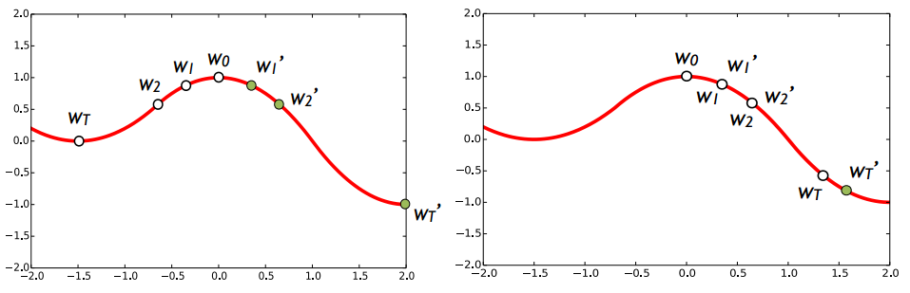
Gradient descent vs. SGD
In (non-stochastic) gradient descent, the stability guarantee no longer holds
Gradient Descent
Stochastic Gradient Descent

Slide 29
Failures of gradient based-methods
Until now we have seen powerful guarantees on SGD’s stability and generalization performances.
However, these guarantees doesn’t ensure small risk, which is our goal. We’ll have a taste of some reasons that cause gradient based methods to fail.
Based on:
[2] Failures of Deep Learning; Shalev-Shwartz, Shamir and Shammah, 2017

Slide 30
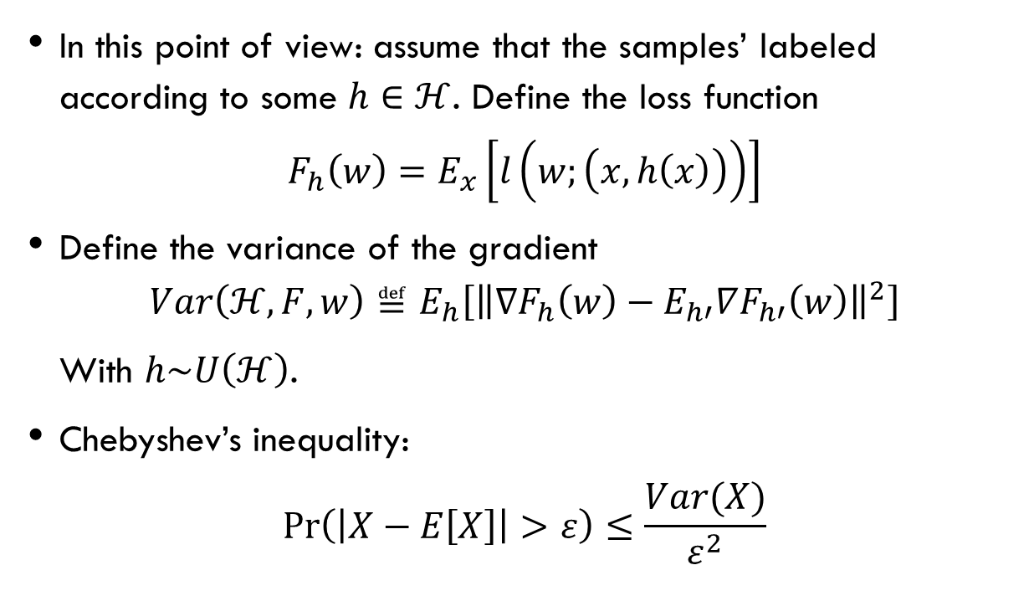
Variance of gradients
In this point of view: assume that the samples’ labeled according to some $h∈ℋ$. Define the loss function
$$F_{h}\left(w\right)=E_{x}\left[l\left(w;\left(x,h\left(x\right)\right)\right)\right]$$
Define the variance of the gradient
$$Var\left(ℋ,F,w\right)≝E_{h}\left[{\left\|∇F_{h}\left(w\right)−E_{h′}∇F_{h′}\left(w\right)\right\|}^{2}\right]$$
With $h\sim U\left(ℋ\right)$.
Chebyshev’s inequality:
$$\operatorname{Pr}\left(\left|X−E\left[X\right]\right|>ε\right)≤\frac{Var(X)}{ε^{2}}$$

Slide 31
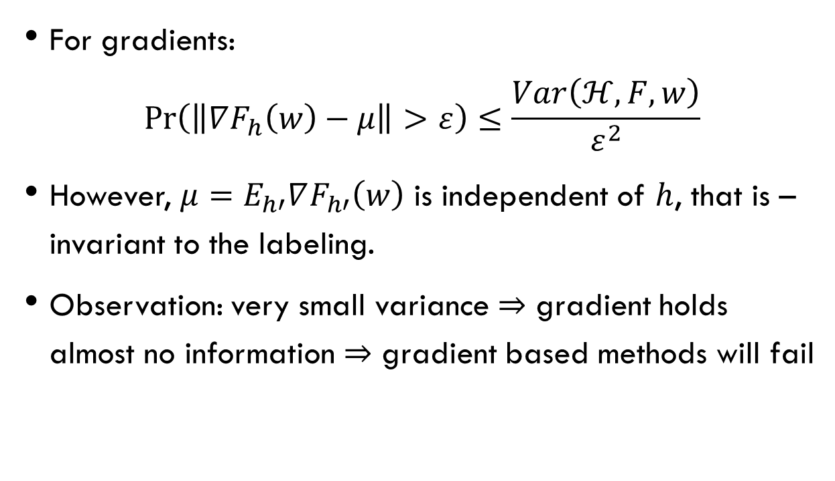
Variance of gradients
For gradients:
$$\operatorname{Pr}\left(\left\|∇F_{h}\left(w\right)−μ\right\|>ε\right)≤\frac{Var\left(ℋ,F,w\right)}{ε^{2}}$$
However, $μ=E_{h′}∇F_{h′}\left(w\right)$ is independent of $h$, that is – invariant to the labeling.
Observation: very small variance $⇒$ gradient holds almost no information $⇒$ gradient based methods will fail

Slide 32
Variance – Applications
Its not surprising that for some piecewise constant loss function the gradient is not informative (zero almost everywhere w.r.t. Lebesgue measure).
However, by ^{[2]} there exists (non-trivial) situations where one can show that the variance is exponentially small – so gradient-based methods are doomed to fail in those situations, even though smoothness and Lipschitzness hold.
Not a contradiction to the stability guarantees!

Slide 33
Bonus: some notes on architecture
So far we only discussed the optimization method of the problem
Some error guarantees are architecture related, regardless of the optimization method – to this end, in this section we will only consider the validation of a trained network.
Based on:
[3] On the Sample Complexity of End-to-end Training vs. Semantic Abstraction Training; Shalev-Schartz and Shashua, 2016

Slide 34
Bonus: some notes on architecture
There are two approaches for NN architecture:
End-to-end
Semantic Abstraction
The end-to-end approach require less preprocessing (labeling) than Semantic Abstraction
Semantic Abstraction, with meaningful components, can lead to extremely high accuracy (as showed in ^{[3]} ).

Slide 35
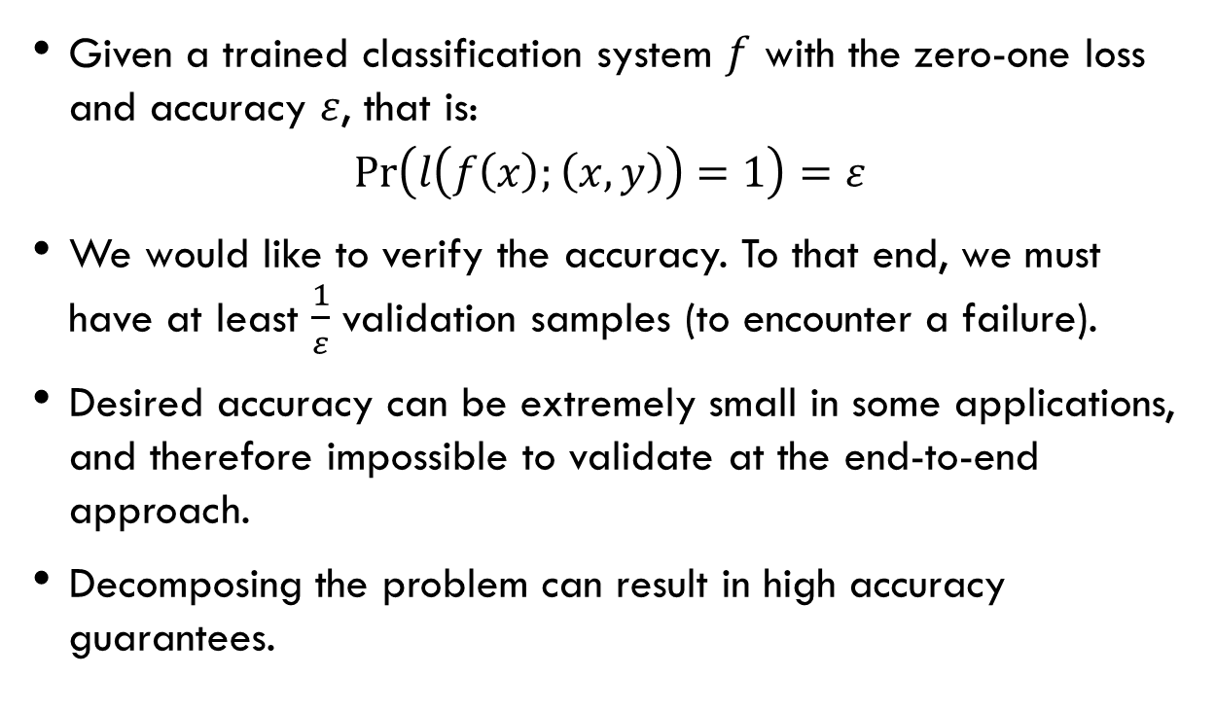
Validation: End-to-end
Given a trained classification system $f$ with the zero-one loss and accuracy $ε$, that is:
$$\operatorname{Pr}\left(l\left(f\left(x\right);\left(x,y\right)\right)=1\right)=ε$$
We would like to verify the accuracy. To that end, we must have at least $\frac{1}{ε}$ validation samples (to encounter a failure).
Desired accuracy can be extremely small in some applications, and therefore impossible to validate at the end-to-end approach.
Decomposing the problem can result in high accuracy guarantees.

Slide 36
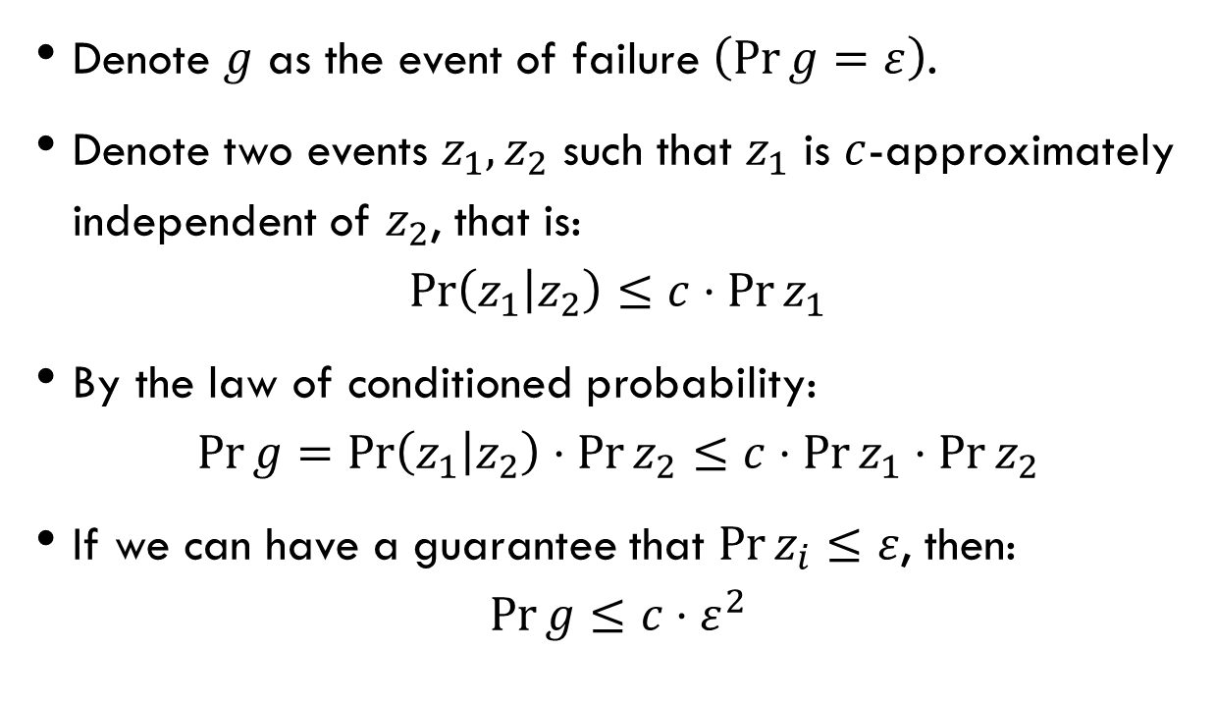
Validation: semantic abstraction
Denote $g$ as the event of failure $\left(\operatorname{Pr}{g}=ε\right)$.
Denote two events $z_{1},z_{2}$ such that $z_{1}$ is $c$-approximately independent of $z_{2}$, that is:
$$\operatorname{Pr}\left(z_{1} | z_{2}\right)≤c⋅\operatorname{Pr}{z_{1}}$$
By the law of conditioned probability:
$$\operatorname{Pr}{g}=\operatorname{Pr}\left(z_{1} | z_{2}\right)⋅\operatorname{Pr}{z_{2}}≤c⋅\operatorname{Pr}{z_{1}}⋅\operatorname{Pr}{z_{2}}$$
If we can have a guarantee that $\operatorname{Pr}{z_{i}}≤ε$, then:
$$\operatorname{Pr}{g}≤c⋅ε^{2}$$

Slide 37
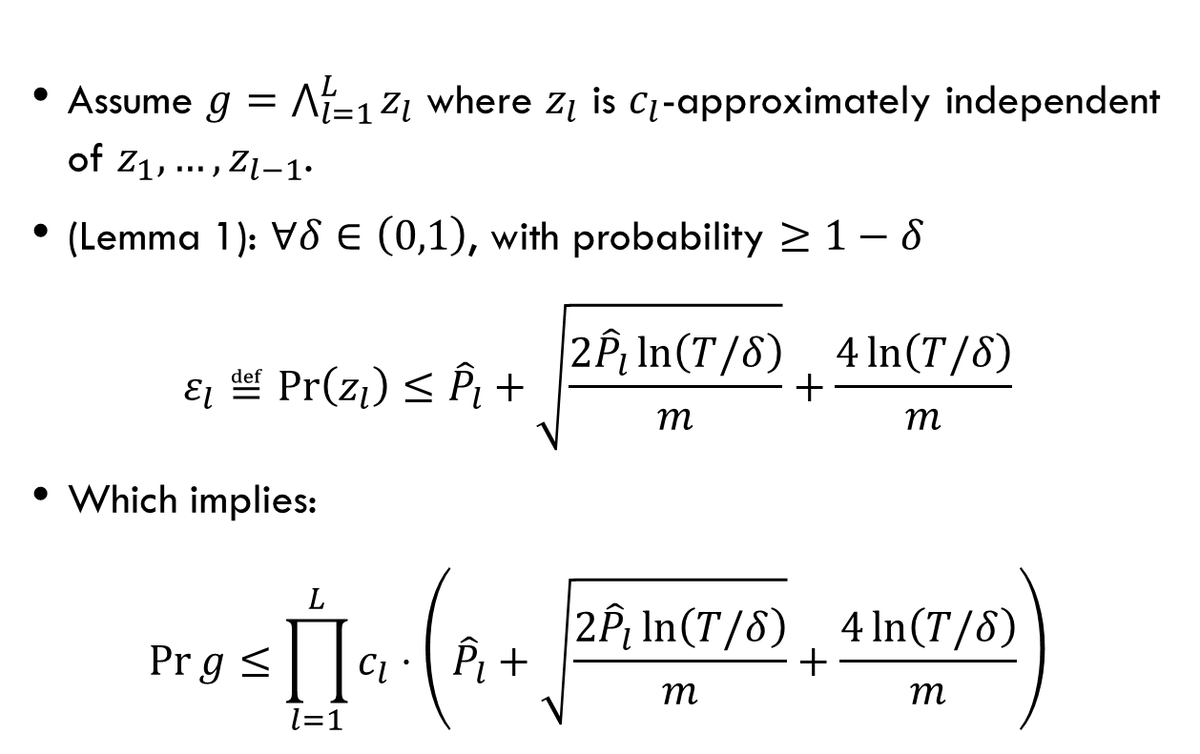
Validation: semantic abstraction
Assume $g=\bigwedge_{l=1}^{L}{z_{l}}$ where $z_{l}$ is $c_{l}$-approximately independent of $z_{1},…,z_{l−1}$.
(Lemma 1): $∀δ∈\left(0,1\right)$, with probability $≥1−δ$
$$ε_{l}≝\operatorname{Pr}\left(z_{l}\right)≤{\hat{P}}_{l}+\sqrt{\frac{2{\hat{P}}_{l}\ln\left(T/δ\right)}{m}}+\frac{4\ln\left(T/δ\right)}{m}$$
Which implies:
$$\operatorname{Pr}{g}≤\prod_{l=1}^{L}{c_{l}}⋅\left({\hat{P}}_{l}+\sqrt{\frac{2{\hat{P}}_{l}\ln\left(T/δ\right)}{m}}+\frac{4\ln\left(T/δ\right)}{m}\right)$$

Slide 38
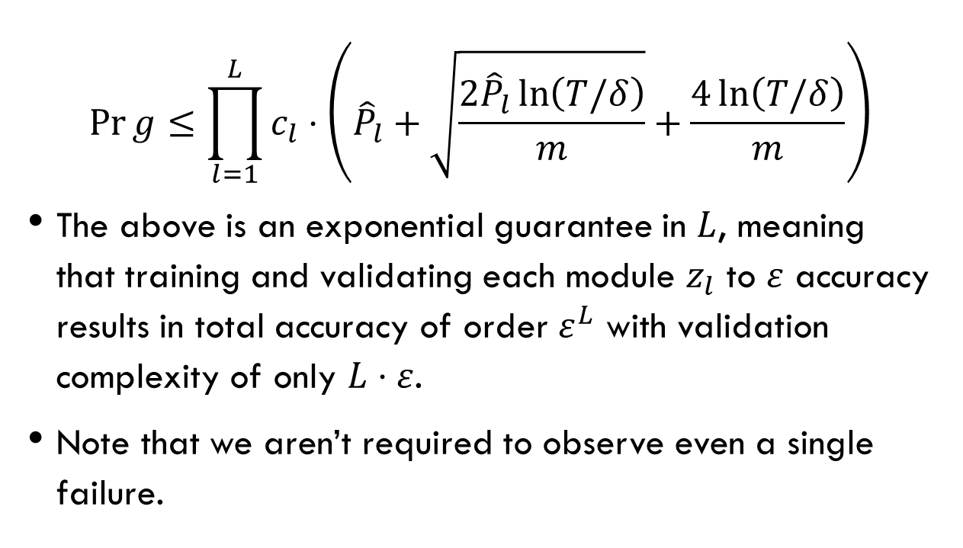
Validation: semantic abstraction
$$\operatorname{Pr}{g}≤\prod_{l=1}^{L}{c_{l}}⋅\left({\hat{P}}_{l}+\sqrt{\frac{2{\hat{P}}_{l}\ln\left(T/δ\right)}{m}}+\frac{4\ln\left(T/δ\right)}{m}\right)$$
The above is an exponential guarantee in $L$, meaning that training and validating each module $z_{l}$ to $ε$ accuracy results in total accuracy of order $ε^{L}$ with validation complexity of only $L⋅ε$.
Note that we aren’t required to observe even a single failure.

